Slide 1
Mrs. Rowe’s Open House
August 29th 2024

Slide 2
Classroom Procedures
Mailbox (Mrs. Rowe’s Pony Express)
Bathroom
Nurse
Snacks/Water Bottle
Change of Dismissal/Contact Office

Slide 3
Student Led Conferences
Student Choice
Data Folders
Math/Science Journals
Math Workbooks

Slide 4
Math Information
Stamps
No Tear Out Pages
Math Centers/30 Minutes
Math Assessments/FSA
iReady

Slide 5
Science Information
Science Center Sheets
Science Journals
Lab Sheets
Science Assessments/NGSSS
Science Fair Project/Judges

Slide 6
Fifth Grade Information
Field Trips/Chaperone
Activity Fee
Fifth Grade Expectations

Slide 7
Reward System
Rowe’s Rodeo Ticket/Fridays
Parent Initials in Planners
iReady Minutes
Class Rewards

Slide 8
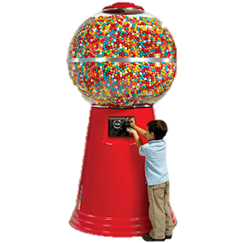
Class Needs
Copy Paper
Paper Towels
1” Gum Balls

Slide 9
Contact Information
Remind
Email: rowet1@leonschools.net
Contact Availability

